Slide 1
US Decision Science
Please view the presentation in slide show
Marketing Planning & Execution Procedures
(Marketing Mix Optimization)
October 2007

Slide 2
MP&E Process Overview
Marketing Planning and Execution (MP&E) is the process used by US Decision Science, LMR, and Lilly USA Sales and Marketing to reconcile spend levels across marketing channels and key player segments for all products as well as portfolio of products.
The analytical framework of the MP&E process is called Promotion Mix Architecture (PMA). The key output of PMA are incremental revenue and contribution curves by brand, key player segment, marketing channel, and, possibly, message type.
In addition to the marketing plan and resource allocation, the incremental revenue and contribution curves are also used by Sales for Call Plan development and physician Targeting, by LMR Forecasting for the development of sales Forecast, and by Marketing for the development of Message Content.
MP&E complements and augments existing marketing effectiveness metrics such as brand equity and preference/loyalty studies. Some of the main questions it addresses are:
• What is the ROI by brand, by channel, by KPS? How has it changed over time?
• What might be the key drivers of ROI?
• How can this information be used to help improve marketing planning and execution?
• How much of our business is due to promotional activities?
• What has carryover been, by KPS?
• What has the historic reach and frequency been?

Slide 3
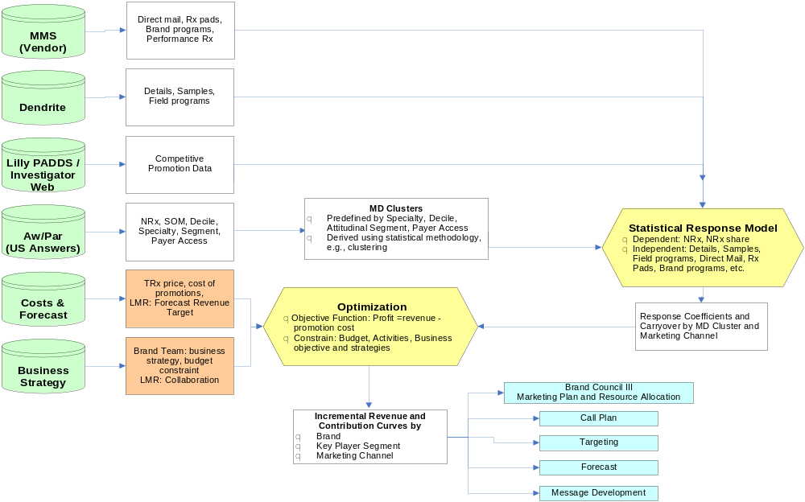
MP&E Process Map
This document focuses on the mix optimization part of the MP&E process

Slide 4
What is marketing mix optimization?
Marketing mix optimization is the USDS methodology to support brand teams with the following decisions:
  What is the right level of spend for the brand?
  How should the overall brand spend be allocated to different key player segments and channels/tactics?
  How should the allocation of spend change for different “What-if” scenarios?
This methodology is also applicable at the business unit/affiliate level where the decisions are at a higher level
  What is the right level of spend for the affiliate/business unit?
  How should the affiliate/business unit level spend be allocated to different brands?
Some parts of the marketing mix optimization outputs feed into:
  Forecasting process
  Call plan process
  Targeting process

Slide 5
Glossary of terms
Channel – Promotional channels used by brand team
  Examples: Details, samples, peer to peer program (field driven, brand driven), direct mail, DTC, etc.
Key player segment - Segments used by brand for planning and execution
  Example: Psych ADP 3-10, PCP ADD 3-10, etc.
Segment – Further breakdown of key player segment for optimization
  Example: Psych ADP 3-10 broken out as Psych ADP 7-10, Psych ADP 3-6, etc.
OPEX – operating expense (spend)
  In this context, OPEX refers to promotional spend
3 Yr Inc Revenue
  Incremental revenue over a 3 year period resulting from OPEX spent in a year
  This would comprise the realized revenue in the first year and revenue in the next 2 years resulting from carryover
3 Yr Inc Contribution
  This refers to profit and is calculated as 3 Yr Inc Revenue – 1 yr OPEX

Slide 6
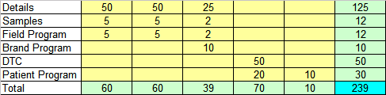
Brand team view of MP&E process
Desired sales goal for the brand
To achieve the desired sales goal we need to achieve the desired brand position in the mind of customers
Achieve desired brand position in the mind of customers
Certain critical success factors (CSF) need to be achieved in the market place to get to the desired brand position
CSF1
CSF2
Following key player objectives (KPO) need to be achieved to get to critical success factors
KPO1
KPO2
KPO3
KPO4
KPO5
Each KPO is relevant to a particular key player segment (KPS)
Channel
KPS1
KPS2
KPS1 and KPS2
What channels/tactics should be used to achieve a certain KPO and how much spend (OPEX) should be allocated to each?
USDS supports the brand team with evaluation/determination of the OPEX allocation

Slide 7
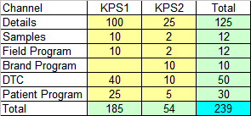
How does USDS analysis fit into the brand team framework?
Desired sales goal for the brand
Impact of final OPEX scenario is an input to forecasting group to enable estimating the impact on total sales forecast
Estimated Incremental share/revenue/contribution for the current OPEX split across channel/KPS
Achieve desired brand position in the mind of customers
Helping the brand evaluate different OPEX scenarios is an iterative process
CSF1
CSF2
Though the mechanism of increasing sales is through achieving KPO/CSF, the historical data analysis directly measure the share/Rx based on historical interventions
This is done using statistical response models
This is done at the channel/KPS level
Response curve by KPS/Channel
KPO1
KPO2
KPO3
KPO4
KPO5
Channel
KPS1
KPS2
KPS1 and KPS2
Not possible to measure impact at KPO level
Possible to measure impact at KPS level
USDS translates brand KPO/Channel OPEX grid to a KPS/Channel OPEX grid

Slide 8
Types of analysis done by USDS
USDS does two types of analysis for the brand teams
Analysis prior to brands receiving hard targets on OPEX
  Brand OPEX is not finalized at this stage and the analysis is more exploratory in nature
  Therefore, It is helpful for the brand to get a overall picture based on incremental revenue/contribution curves
  These curves help give context to the following questions
    How the brand OPEX compares with the optimal range of OPEX suggested by the model?
    How efficient is the planned OPEX allocation?
    How much increase in revenue is possible by redistributing the planned OPEX differently among channels and segments?
Analysis after brands receive hard targets on OPEX
  At this stage, brand OPEX is mostly finalized and the analysis is more specific to answer following questions
    How to use the given OPEX by channel and segment?
    If the hard target is less than originally planned OPEX, which are the channels/KPS where OPEX should be reduced?
    If a buy-up is approved, which are the areas where the OPEX should be added?
USDS has an internal tool that helps with answering the above questions

Slide 9
USDS tool for performing mix optimization
Mix optimization is implemented using Scenario Evaluation Tool (SET)
SET is used for performing following analysis for brand teams:
  Create incremental revenue/contribution curves at different levels of granularity (brand/KPS/channel)
  Perform what-if analysis comparing different OPEX scenarios in terms of incremental revenue/incremental contribution
SET also creates sales response curves that feed the ELMO tool used for the call plan process
SET solves an optimization problem that chooses the decision variables to optimize a given criteria subject to constraints:
  Decision variables – Frequency/MD/qtr for each channel, segment, qtr
  Optimization criteria – Maximize 3 year incremental contribution
  Constraints – Constraints on activity, spend etc.

Slide 10
How does SET work conceptually?
Decision variable for each channel, segment,qtr
Freq/MD/qtr
Cost per exposure
Response model
Cost/MD/qtr
Inc NRx shr/MD/qtr
3 Yr Inc Contribution/MD/qtr
=3 Yr Inc Revenue/MD/qtr-Cost/MD/qtr
Mkt NRx/MD/qtr
Inc NRx/MD/qtr
% Reach for channel/segment
Refill ratio
#MDs in each segment
Inc TRx/MD/qtr
3 Yr impact of 1 qtr effort (calculated using lag, spread)
Sum across all channel,segment,qtr
3 yr Inc TRx/MD/qtr
Price Per Rx
3 Yr Inc Contribution
(Maximize subject to user specified constraints)
3 yr Inc Revenue/MD/qtr

Slide 11
References for further details on SET
SET training materials
SET user documentation
Rest of the presentation gives examples of how SET is utilized in the marketing planning process

Slide 12
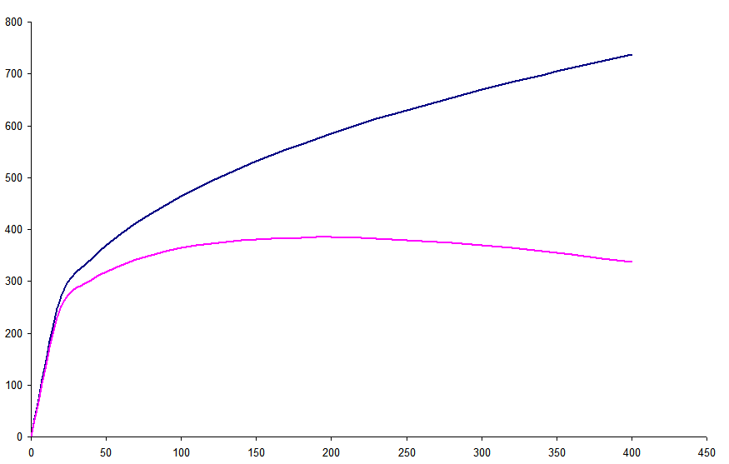
Response curve at brand/KPS level
Core output of MPE process is incremental revenue/contribution curves at different levels of granularity
3 Yr Inc Revenue Response Curve
(Maximum revenue at a given level of spend)
Inc Revenue/Contribution Curve is generated in SET by running a sequence of OPEX constrained scenarios
Each point on the curve corresponds to finding the maximum contribution/revenue at the opex level for that point
Opportunity to increase revenue at baseline spend by changing channel/segment mix
Opportunity to increase contribution by reducing spend
3 Yr Inc Rev/Contribution ($MM)
Brand baseline Incremental Rev
Inc Contribution Curve
(3 Yr Inc Rev-1 Yr Spend)
Optimal spend
range
Brand baseline spend
Spend ($MM)

Slide 13

Evaluation of “What-if” scenarios-1
Evaluate brand team allocation of OPEX
(Baseline scenario)
SET input constraint (OPEX by KPS/Channel)
Brand team opex allocated to each channel/KPS combination is forced as a constraint in SET
SET Outputs
OPEX by KPS/Channel
OPEX output by channel/KPS is the same as OPEX input because it is constrained to be that way
Overall 3 Yr inc revenue/contribution impact of current OPEX allocation scenario

Slide 14
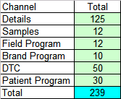
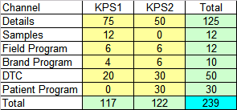
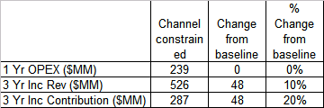
Evaluation of “What-if” scenarios-2
What-if OPEX is constrained to brand input only for channels but allowed to float across KPS? (Channel constrained scenario)
SET input constraint (OPEX by channel)
Brand team opex allocated to each channel is forced as a constraint in SET
SET Outputs
OPEX by KPS/Channel
Total OPEX for each channel is same as input because of constraints
However, SET optimization determines how that channel OPEX needs to be allocated to KPS 1 and 2
Brand allocation of spend for KPS1/KPS2 was 77%/22%
However,model allocation of spend for KPS1/KPS2 is 49%/51%
Overall 3 Yr inc revenue/contribution impact of current OPEX allocation scenario
Reallocating channel spend among KPS results in a 10% increase in incremental revenue without any change in OPEX

Slide 15
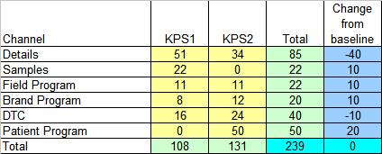
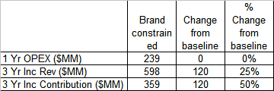
Evaluation of “What-if” scenarios-3
What-if OPEX is constrained to brand input only for the overall brand but allowed to float across channel and KPS? (Brand constrained scenario)
SET input constraint (OPEX for brand)
Total brand spend of $239MM is imposed as a constraint in SET
SET Outputs
OPEX by KPS/Channel
Total OPEX for the brand is same as input due to constraints
However, SET optimization determines how the brand OPEX is allocated by KPS and channel
Model suggests reducing spend in Details and DTC and distributing it to other channels
Overall 3 Yr inc revenue/contribution impact of current OPEX allocation scenario
Reallocating brand spend among channel and KPS results in a 25% increase in incremental revenue without any change in OPEX

Slide 16
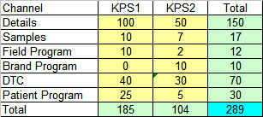
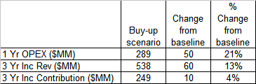
Evaluation of “What-if” scenarios-4
Buy-up Scenario
Suppose the brand intends to go with the baseline scenario of allocating $239MM OPEX
They get an additional buy-up of $50MM and want to know where to spend it
SET input constraint
SET constraints impose that the allocation of spend by KPS/Channel be AT LEAST the amount allocated in baseline scenario
+$50MM
Total brand OPEX is constrained to $289MM (239+50)
SET output
The model allocated the additional $50MM dollars to KPS2:
$25MM to details in KPS2
$5MM to samples in KPS2
$20MM to DTC in KPS2
The extra $50MM generates a 3 Yr Inc revenue of $60MM (Inc ROI of 1.2)

Slide 17
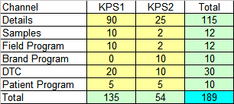
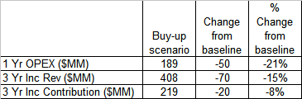
Evaluation of “What-if” scenarios-5
OPEX reduction Scenario
Suppose the brand intends to go with the baseline scenario of allocating $239MM OPEX
They get a OPEX cut of $50MM and want to know which areas to pull back spend
SET input constraint
SET constraints impose that the allocation of spend by KPS/Channel be AT MOST the amount allocated in baseline scenario
-$50MM
Total brand OPEX is constrained to $189MM (239-50)
SET output
The model removes $50MM dollars from KPS1:
$10MM from KPS1 details
$20MM from KPS1 DTC
$20MM from KPS1 patient program
The reduction in $50MM in OPEX results in reduction of 3 yr inc revenue of $70MM

Slide 18
Interpretation for the brand team
The goal of USDS analysis is not to drive brand decisions but rather help them think through their decisions by providing a data based perspective
  Below are couple of examples of how this might work
Suppose the brand OPEX is higher than optimal model range
  This is not to be taken as an indication that the OPEX needs to reduce
  But this should trigger a thought process where the brand team is able to articulate the reasons behind their decision
    For example, the reasoning may be as follows
      This is a launch product and all of the upside potential is not yet realized
      USDS models are based on historical data and hence may be on the conservative side
      Therefore I am comfortable with my decision on OPEX
Suppose the brand OPEX efficiency is at 85%
  This is because the brand split of OPEX between PCP and Psych is 50%/50% but the model split between PCP and Psych is 70%/30%
  This should trigger a thought process which may lead to reasoning as follows
    The model is probably underestimating the importance of psychs since it is based on some programs that we did last year where we found that content was not effective
    However, we have a brand new content for psychs next year which we think will have a higher impact but we don’t know by how much
    Maybe, I can go with a 60%/40% PCP/Psych split which is a middle ground between my intuition and model recommendation

